Slide 1
Planning the FTC Season
Presented by Ron Pittwood

Slide 2
Introduction
Introductions
This presentation is aimed at new coaches with no or limited frame of reference
The presentation will provide a high level framework and timeline for the season.
The framework is just that. If you don’t have one, you need one!
Notes:
Tip: Add your own speaker notes here.

Slide 3
Considerations
What are you trying to accomplish with your Team?
Why are you coaching a FTC Team?
Discussion
Notes:
Tip: Add your own speaker notes here.

Slide 4
Some Planning Thoughts
What are your goals for the season? It is hard to know where you are if you don’t know where you are going.
How many tournaments do you want to attend?
When and where will you meet?
What tools and machinery do you have available?
Where will you go for help?
What skills and abilities does the team possess? CAD? Programming?

Slide 5
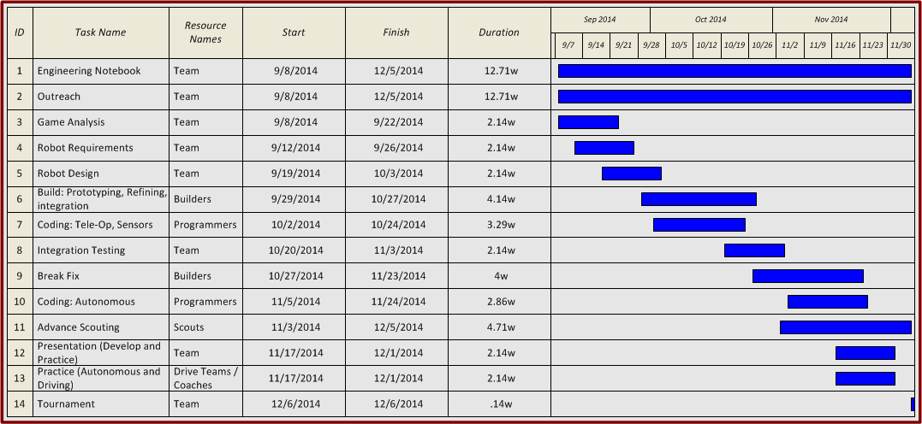
Suggested Timeline
Notes:
Tip: Add your own speaker notes here.

Slide 6
Timeline discussion
Engineering Notebook – Well documented requirements in the Game Manual – follow exactly! Everyone on team should contribute – may want to make one person responsible to make sure everyone makes entries – Every meeting, outreach, tournament, etc should generate entries in the Engineering Notebook

Slide 7
Timeline Discussion
Outreach
Lots of suggestions and ideas are available
Engage with SAE
Do Presentations to PTA, School Board, Organizations, etc.
Social Media

Slide 8
Timeline Discussion
Game Analysis
What is the game, really?
Think of primary and alternate strategies
Think about how the opposing Alliance may play
Think about what your Alliance Partner might do
This is a very critical step for Autonomous
Autonomous can be used to strategically place your bot before Tele-Op
Early in the season teams may have few or no autonomous
Don’t go to a tournament without at least one!

Slide 9
Timeline Discussion
What strategy maximizes the opportunity for success and minimizes the opportunity for failure?
Everybody participates in the discussion
Small group breakout sessions
Role play, diagrams, walk through scenarios
No bad ideas at this point
Explore every option
Decide best strategies

Slide 10
Timeline Discussion
Robot Requirements
Now that the Team has decided how they want to play the game, they have to decide what features and capabilities the Robot must have
Get specific!
Things like – Has to prevent balls from getting under the bot or Can’t get hung up coming down or going up the ramp
The better defined the requirements are, the better off the team will be – Don’t let them escape without fully defining the requirements!

Slide 11
Timeline Discussion
Robot Design
Have your Team:
Think about what they want the robot to do
Think about how the robot can do it
Think about machines that can do what you need done. How do they work?
Think how your idea could be blocked or defended
Think carefully about this aspect
A good robot is robust. Aim for “bombproof”
Your team will want to be building instead of thinking. Make them spend the time – it will save days later on.
Coach! Ask How and Why questions. Make the team justify and agree on how they want to approach the game. Facilitate the discussion if needed

Slide 12
Timeline Discussion
Robot Design
Settle on ideas for the design of the robot and any manipulators or devices
Try to create CAD drawings if you have the capability on the Team.
Think Modular – You have to be able to service, repair and / or replace pieces during a tournament – Pressure is having 3 minutes to replace a motor you can’t reach

Slide 13
Timeline Discussion
Build Step 1- Prototypes, Refinements, Integration
Create prototypes to prove out concepts. Prototypes can be very simple. This is another time saver.
Objective evaluations – Measure results – Document the process and get it in the engineering notebook!
Build the prototype into a candidate part. There may be several iterations of the mechanism or part before the competition ready piece is done.
Build out rolling frame – The drive train is an early decision

Slide 14
Timeline Discussion
Coding Step 1 – Tele-Op and Sensors
Program basic robot movement (driving controls)
Build a “test bed” for programmers to experiment with sensors
Document the code and come up with a code management system
Build Step 2 – Integration Testing, Break / Fix
Start moving components onto the bot. Test them, break them, fix them, improve them

Slide 15
Timeline Disscussion
Coding Step 2 – Autonomous
As the robot build out nears completion programmers should work on Autonomous programming
There are multiple starting positions and your team should be prepared for any of them
Document the code – describe every step (add a Test program)
Use the 3x rule – the program must execute perfectly 3 times in a row to be considered good.
Placement of the robot at the start is critical. Has to be consistent – Practice!
Checklists are a really good idea!

Slide 16
Timeline Discussion
Advance Scouting
The idea is to build relationships with other teams – and not just for the immediate purpose of the tournament
Use social media – Twitter, Facebook, YouTube, Skype, etc.
Use the team list published before the tournament to scout – you’d be amazed what you will find!
Presentation – Develop and Practice
Trying to present the team, the robot and tell the judges what you have done during the season. Tell the story of your season
Keep the presentation portion to about 5 minutes – make the judges want more info
Practice!

Slide 17
Timeline Discussion
Robot Practice – Autonomous and Driving
This is a critical step
Builds consistency
Builds knowledge of the robots capabilities
Makes the drivers and on field coach better at making decisions on the field
Often a deciding factor in matches
Build a checklist to service the robot between matches
Tournament!

Slide 18
Planning Wrap Up
Q&A

